Slide 1
Lending club case study

Slide 2
Problem Statement
•Lending Club is a Consumer Finance company for who is interested to understand if a new loan application can be accepted or rejected.
•We have a dataset with loan data that are currently active, paid off or charged-off.
•We are advising the company with driver variables to avoid credit loss using EDA.
•We have done univariate and bivariate analysis on the dataset. We have derived metrics which is required.
•We have made assumptions based on publicly available domain information.
•As data imputations can’t be reliably done, this step is skipped and the columns with empty values are dropped from analysis.
•We have also not considered the loan data for the currently active loans as we can’t predict drivers from this.
•Also, we have dropped customer behavior variables as this will be unique and can’t be used to generalize/ aggregate the data.

Slide 3
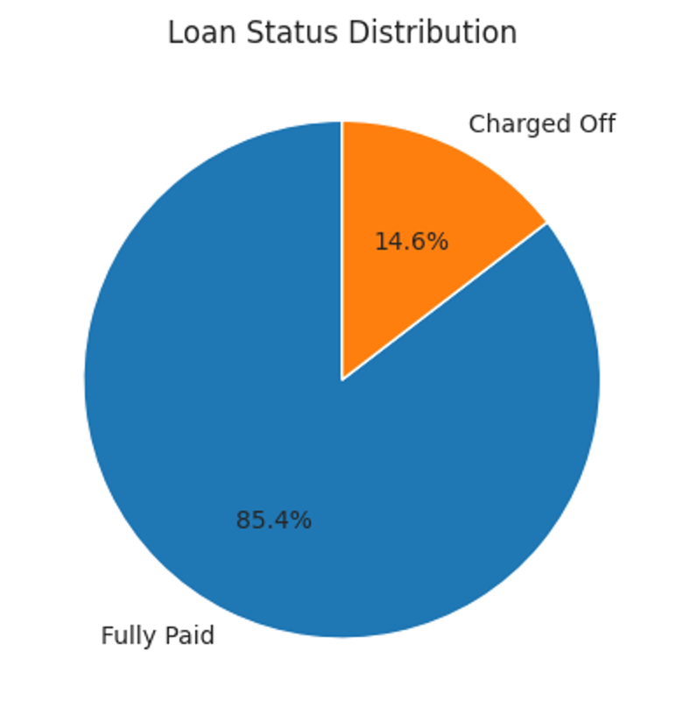
Insights
14% of the loans are defaulted

Slide 4
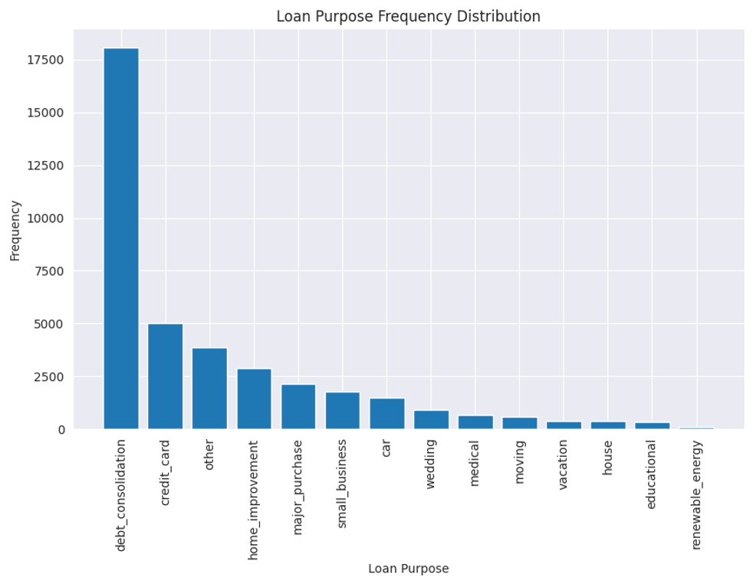


Slide 5
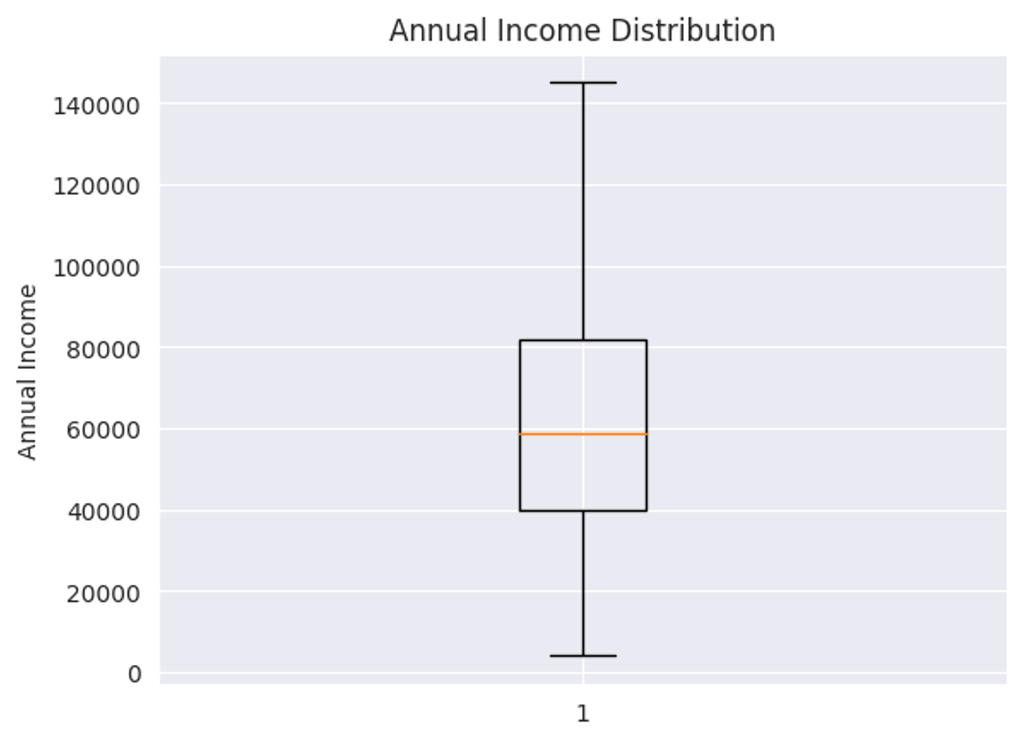
25 Percent of people earn less than 40,000 per year
50 Percent of people earn less than 60,000 per year
75 Percent of people earn less than 80,000 per year
Lowest reported income is 4K while the highest reported income is 60L¶
Median annual income is 60000 USD

Slide 6
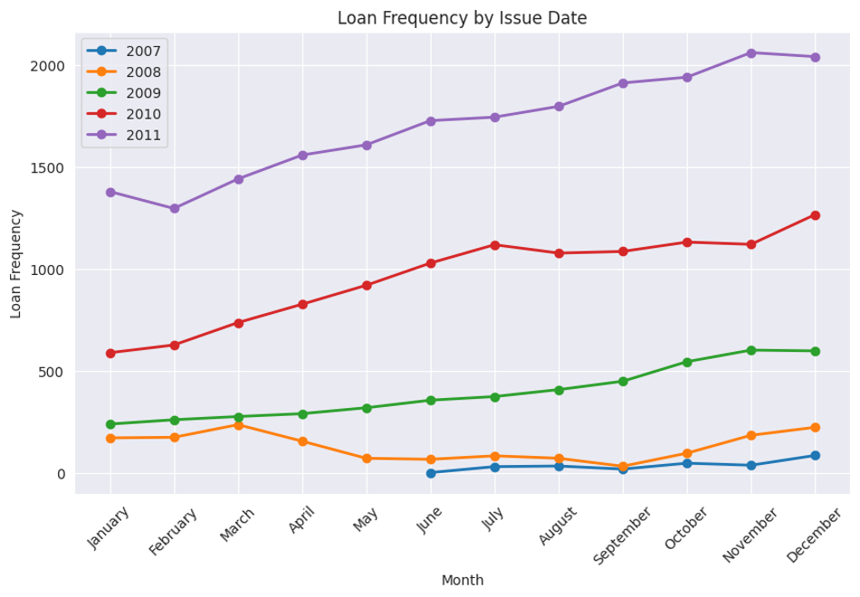
- Most of the loans get funded in December
- The company has grown steadily as the funded loans show a steady increase over the years

Slide 7
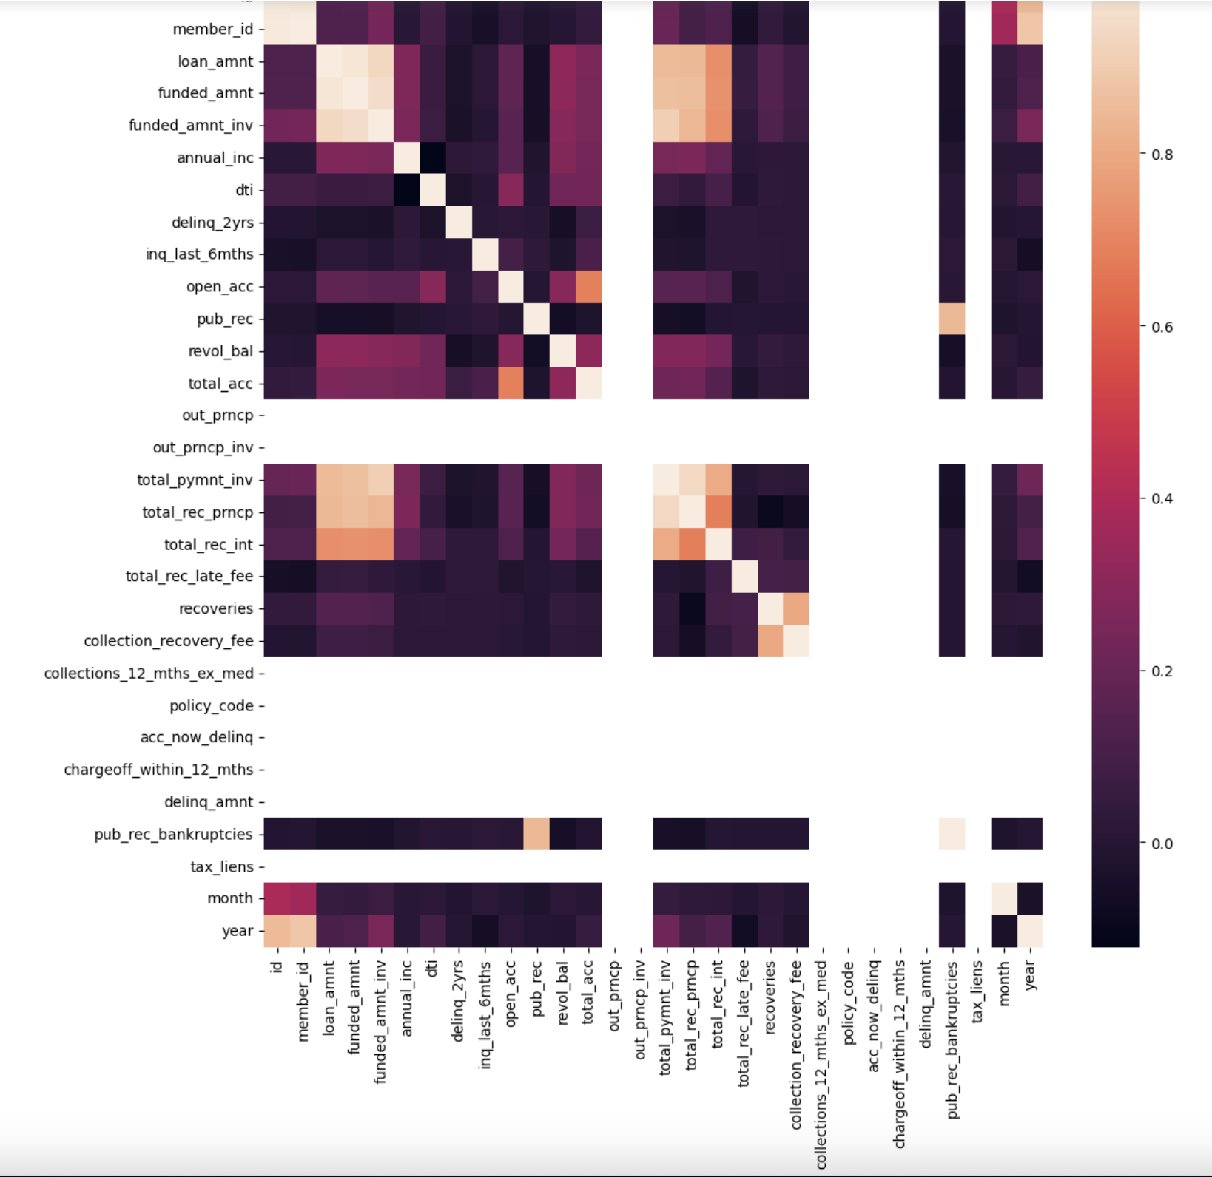
- Bivariate analysis
Correlation between all columns

Slide 8
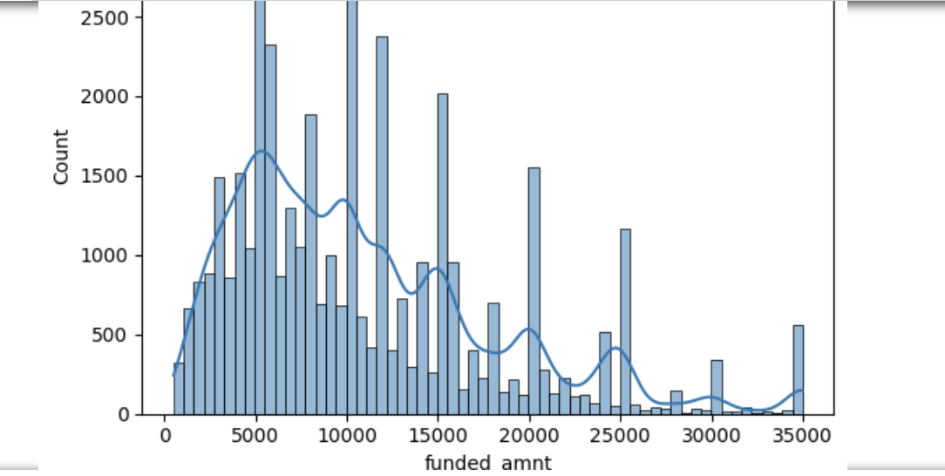
- Histogram plot for all variables for frequency v/s column value
For eg. this plot is for funded amount v/s count

Slide 9
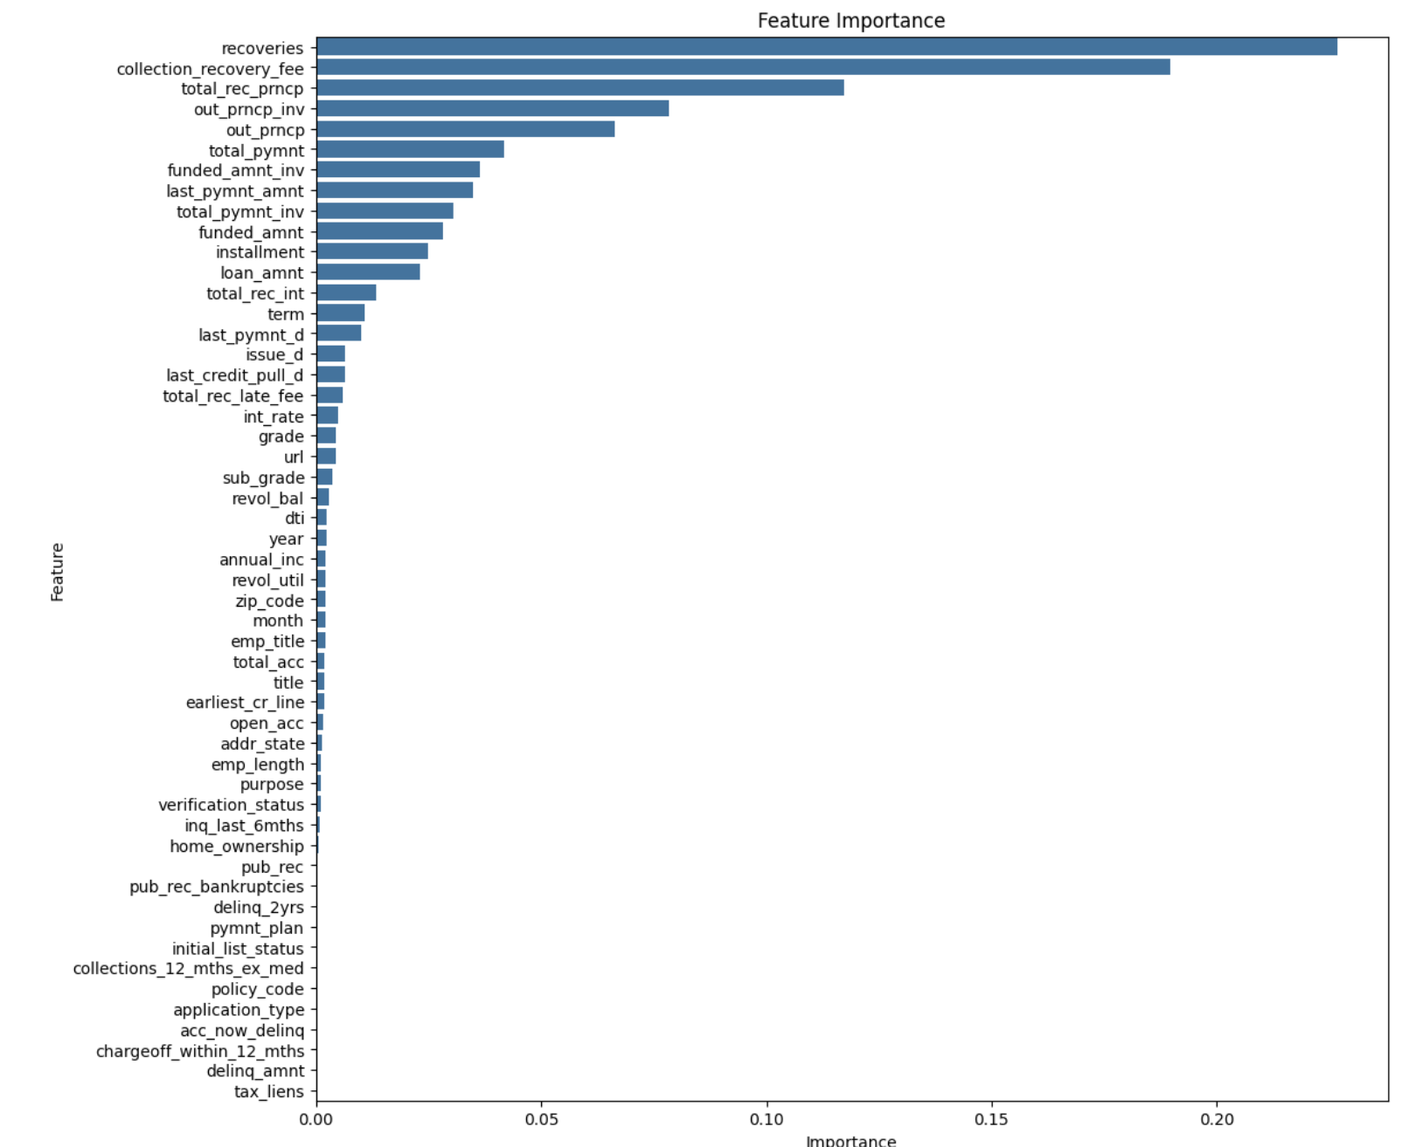
- Feature importance plot gives the importance for each feature. Recoveries seems to be the most important feature.

